Slide 1

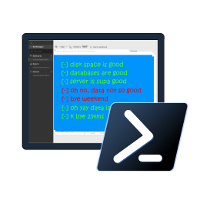

SQL Notebooks in Azure Data Studio for the DBA
Rob Sewell -@SQLDBAWithBeard

Slide 2
WHO AM !?

Slide 3
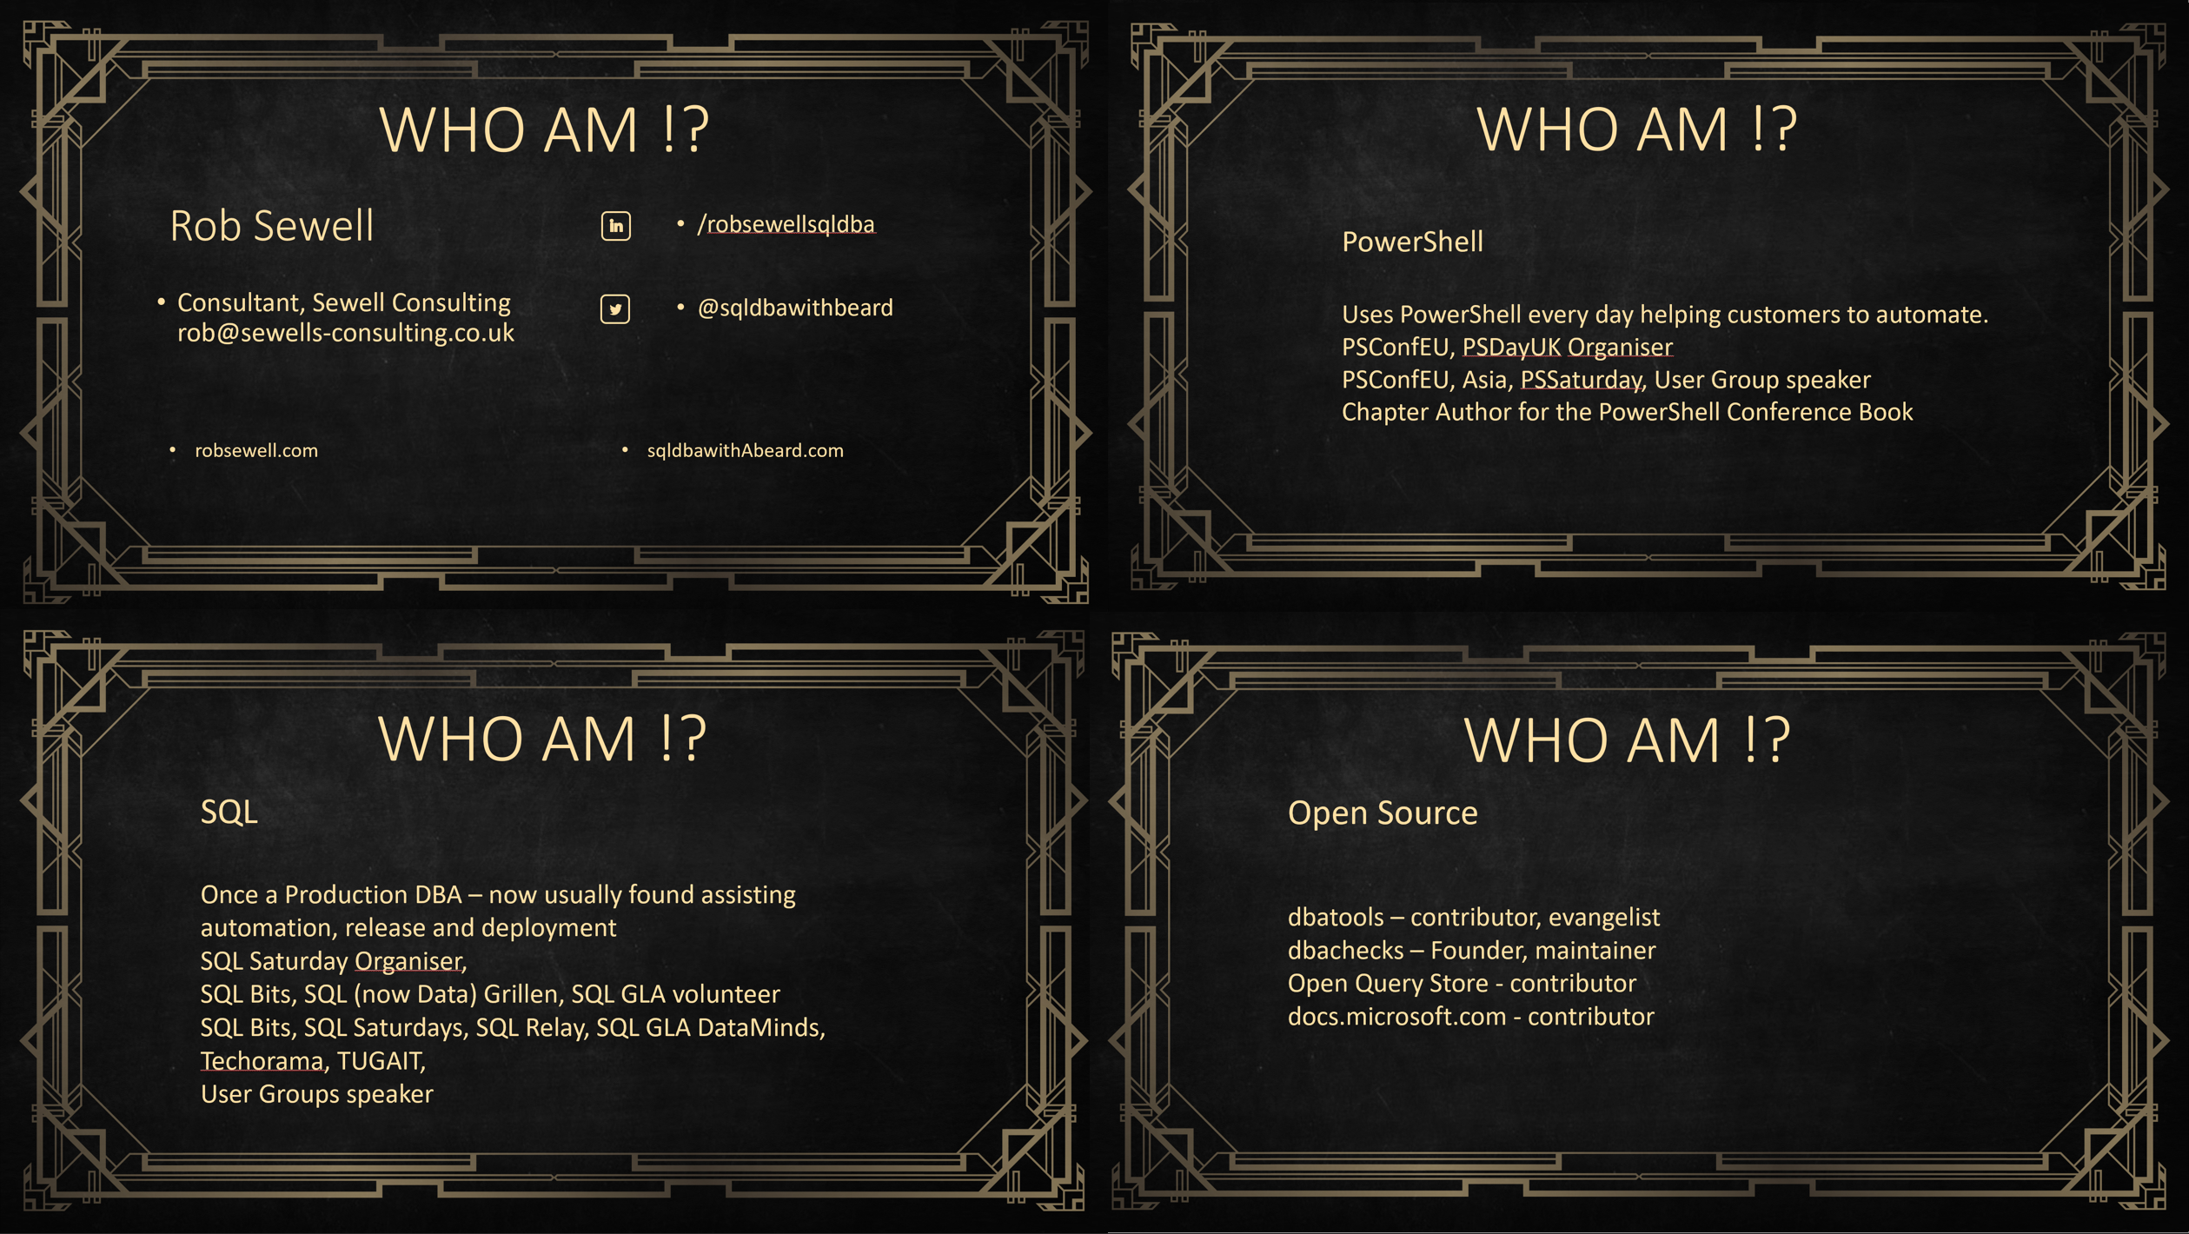


Slide 4
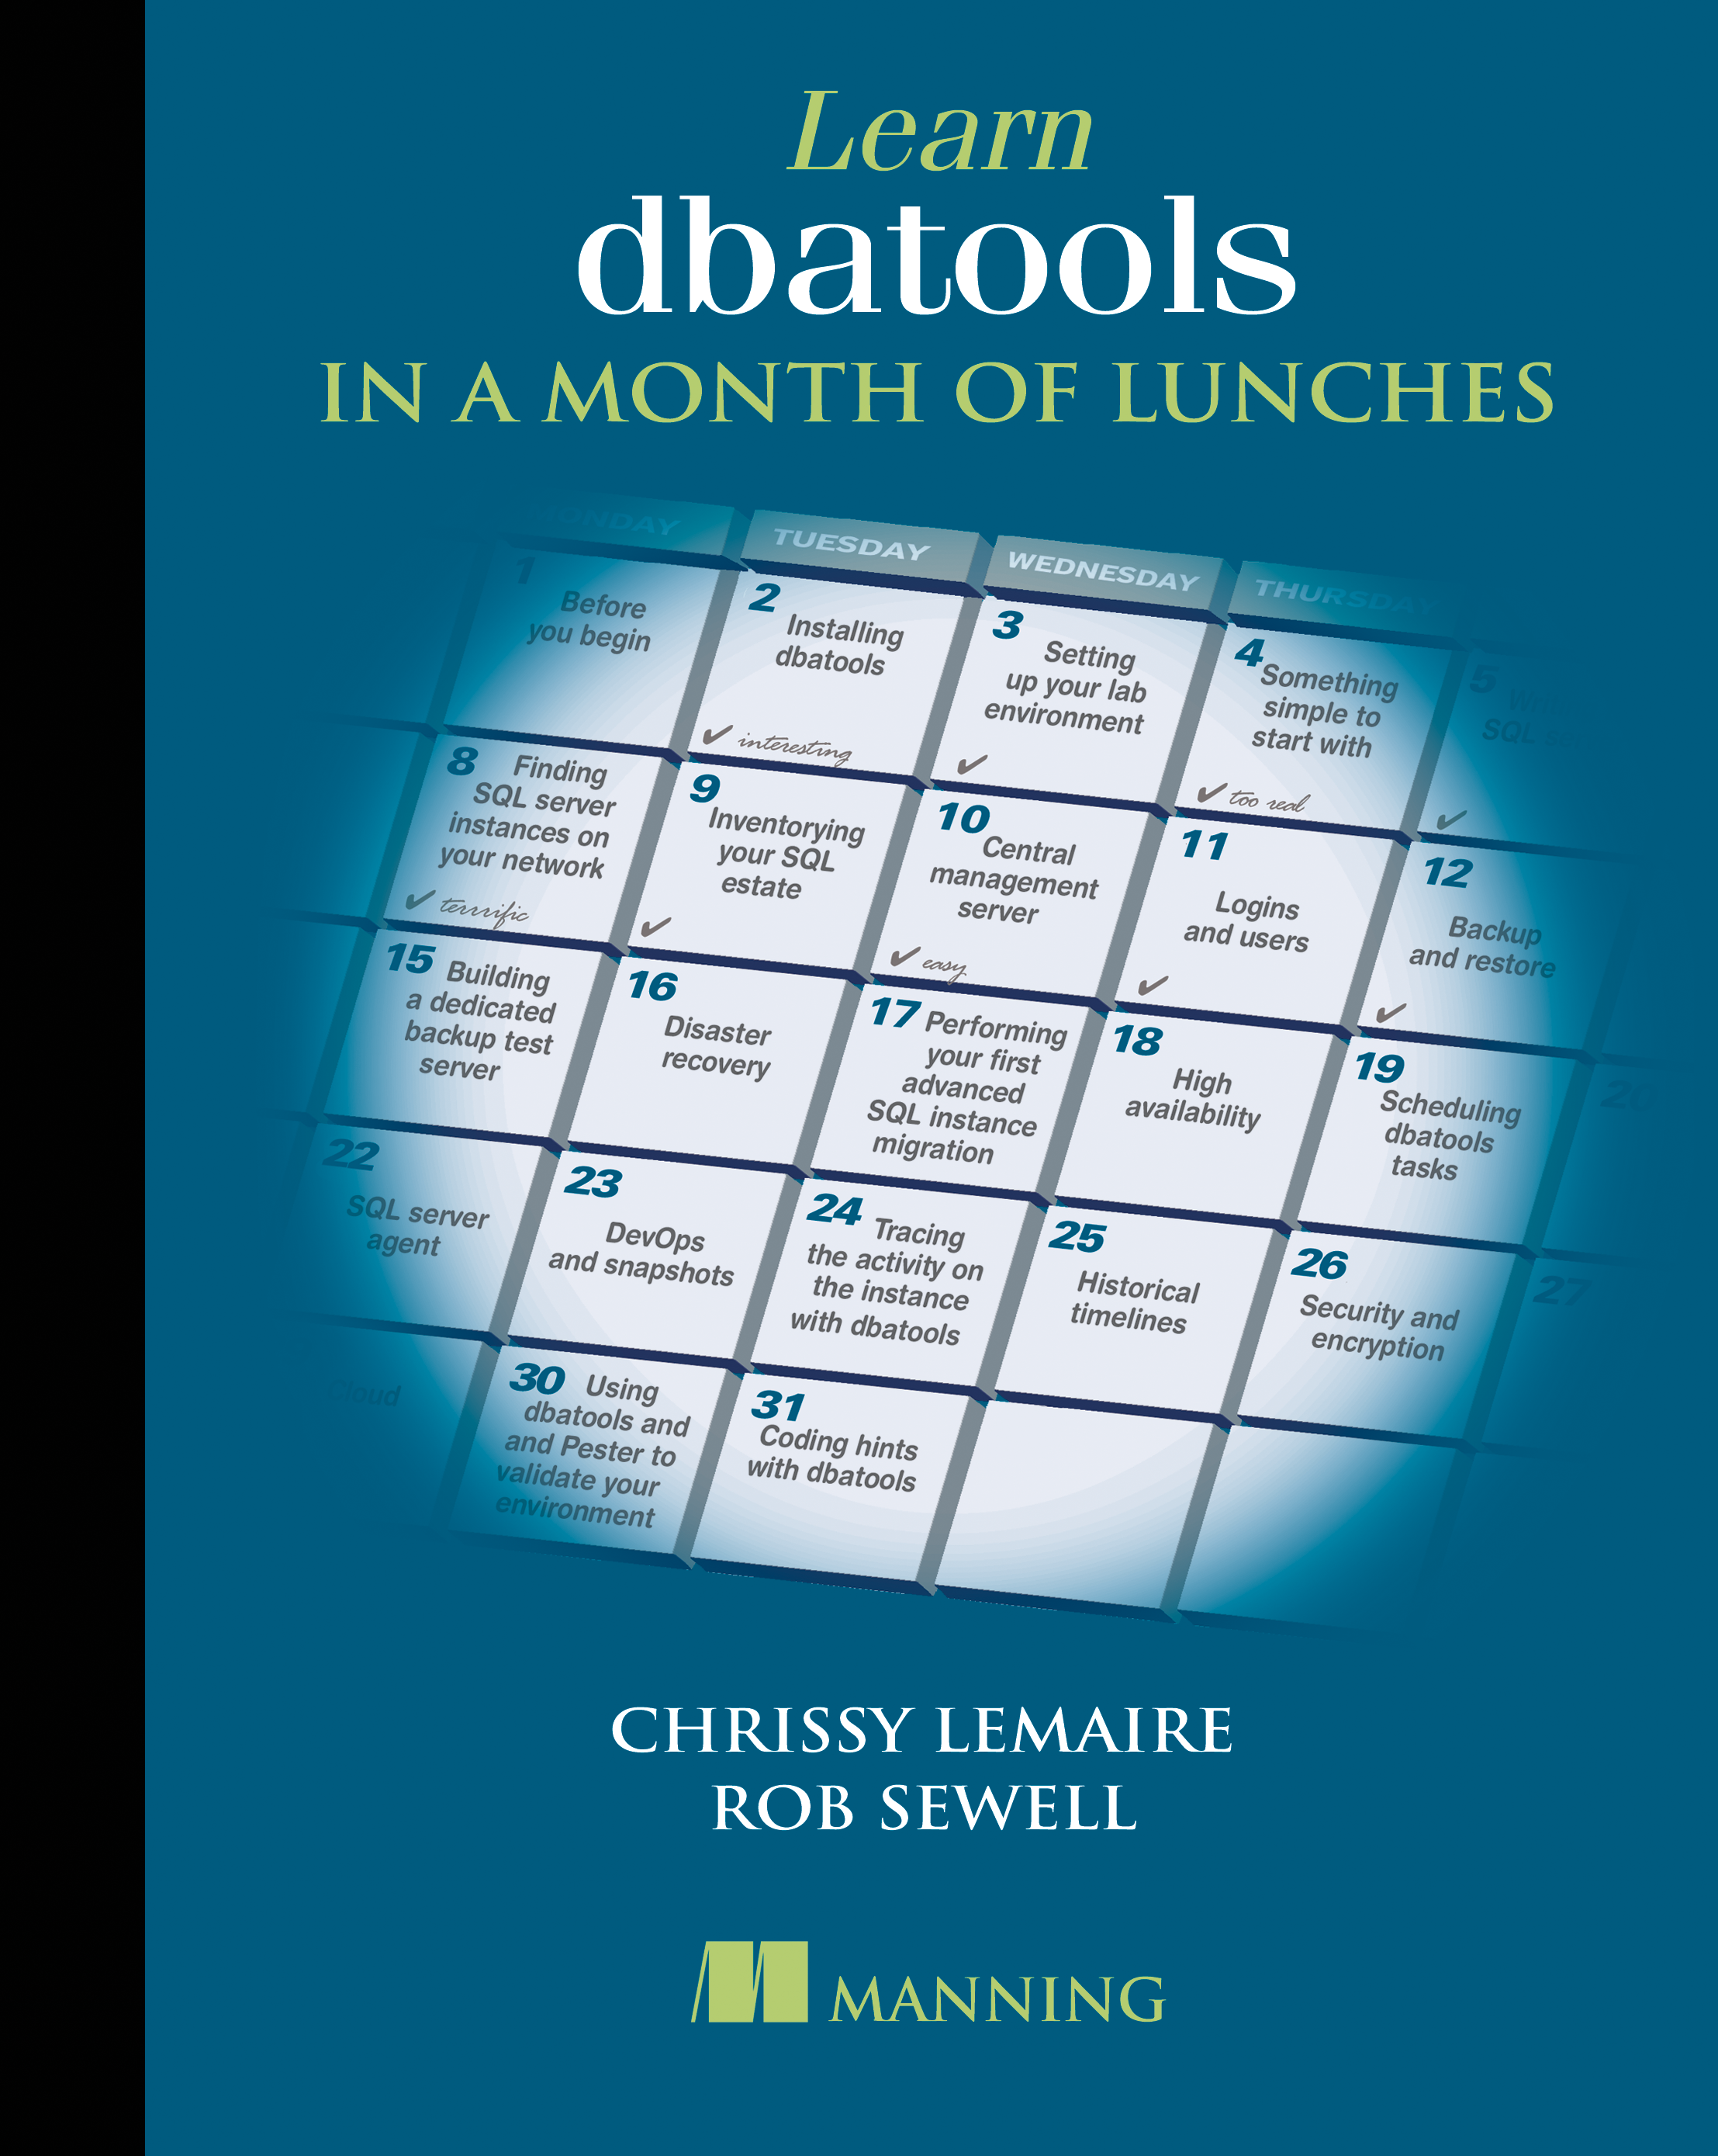
Here Now ! dbatools.io/book
The MEAP has opened for dbatools in a Month of Lunches
New book from Manning
Your Code for 50% off ctwdhld19

Slide 5








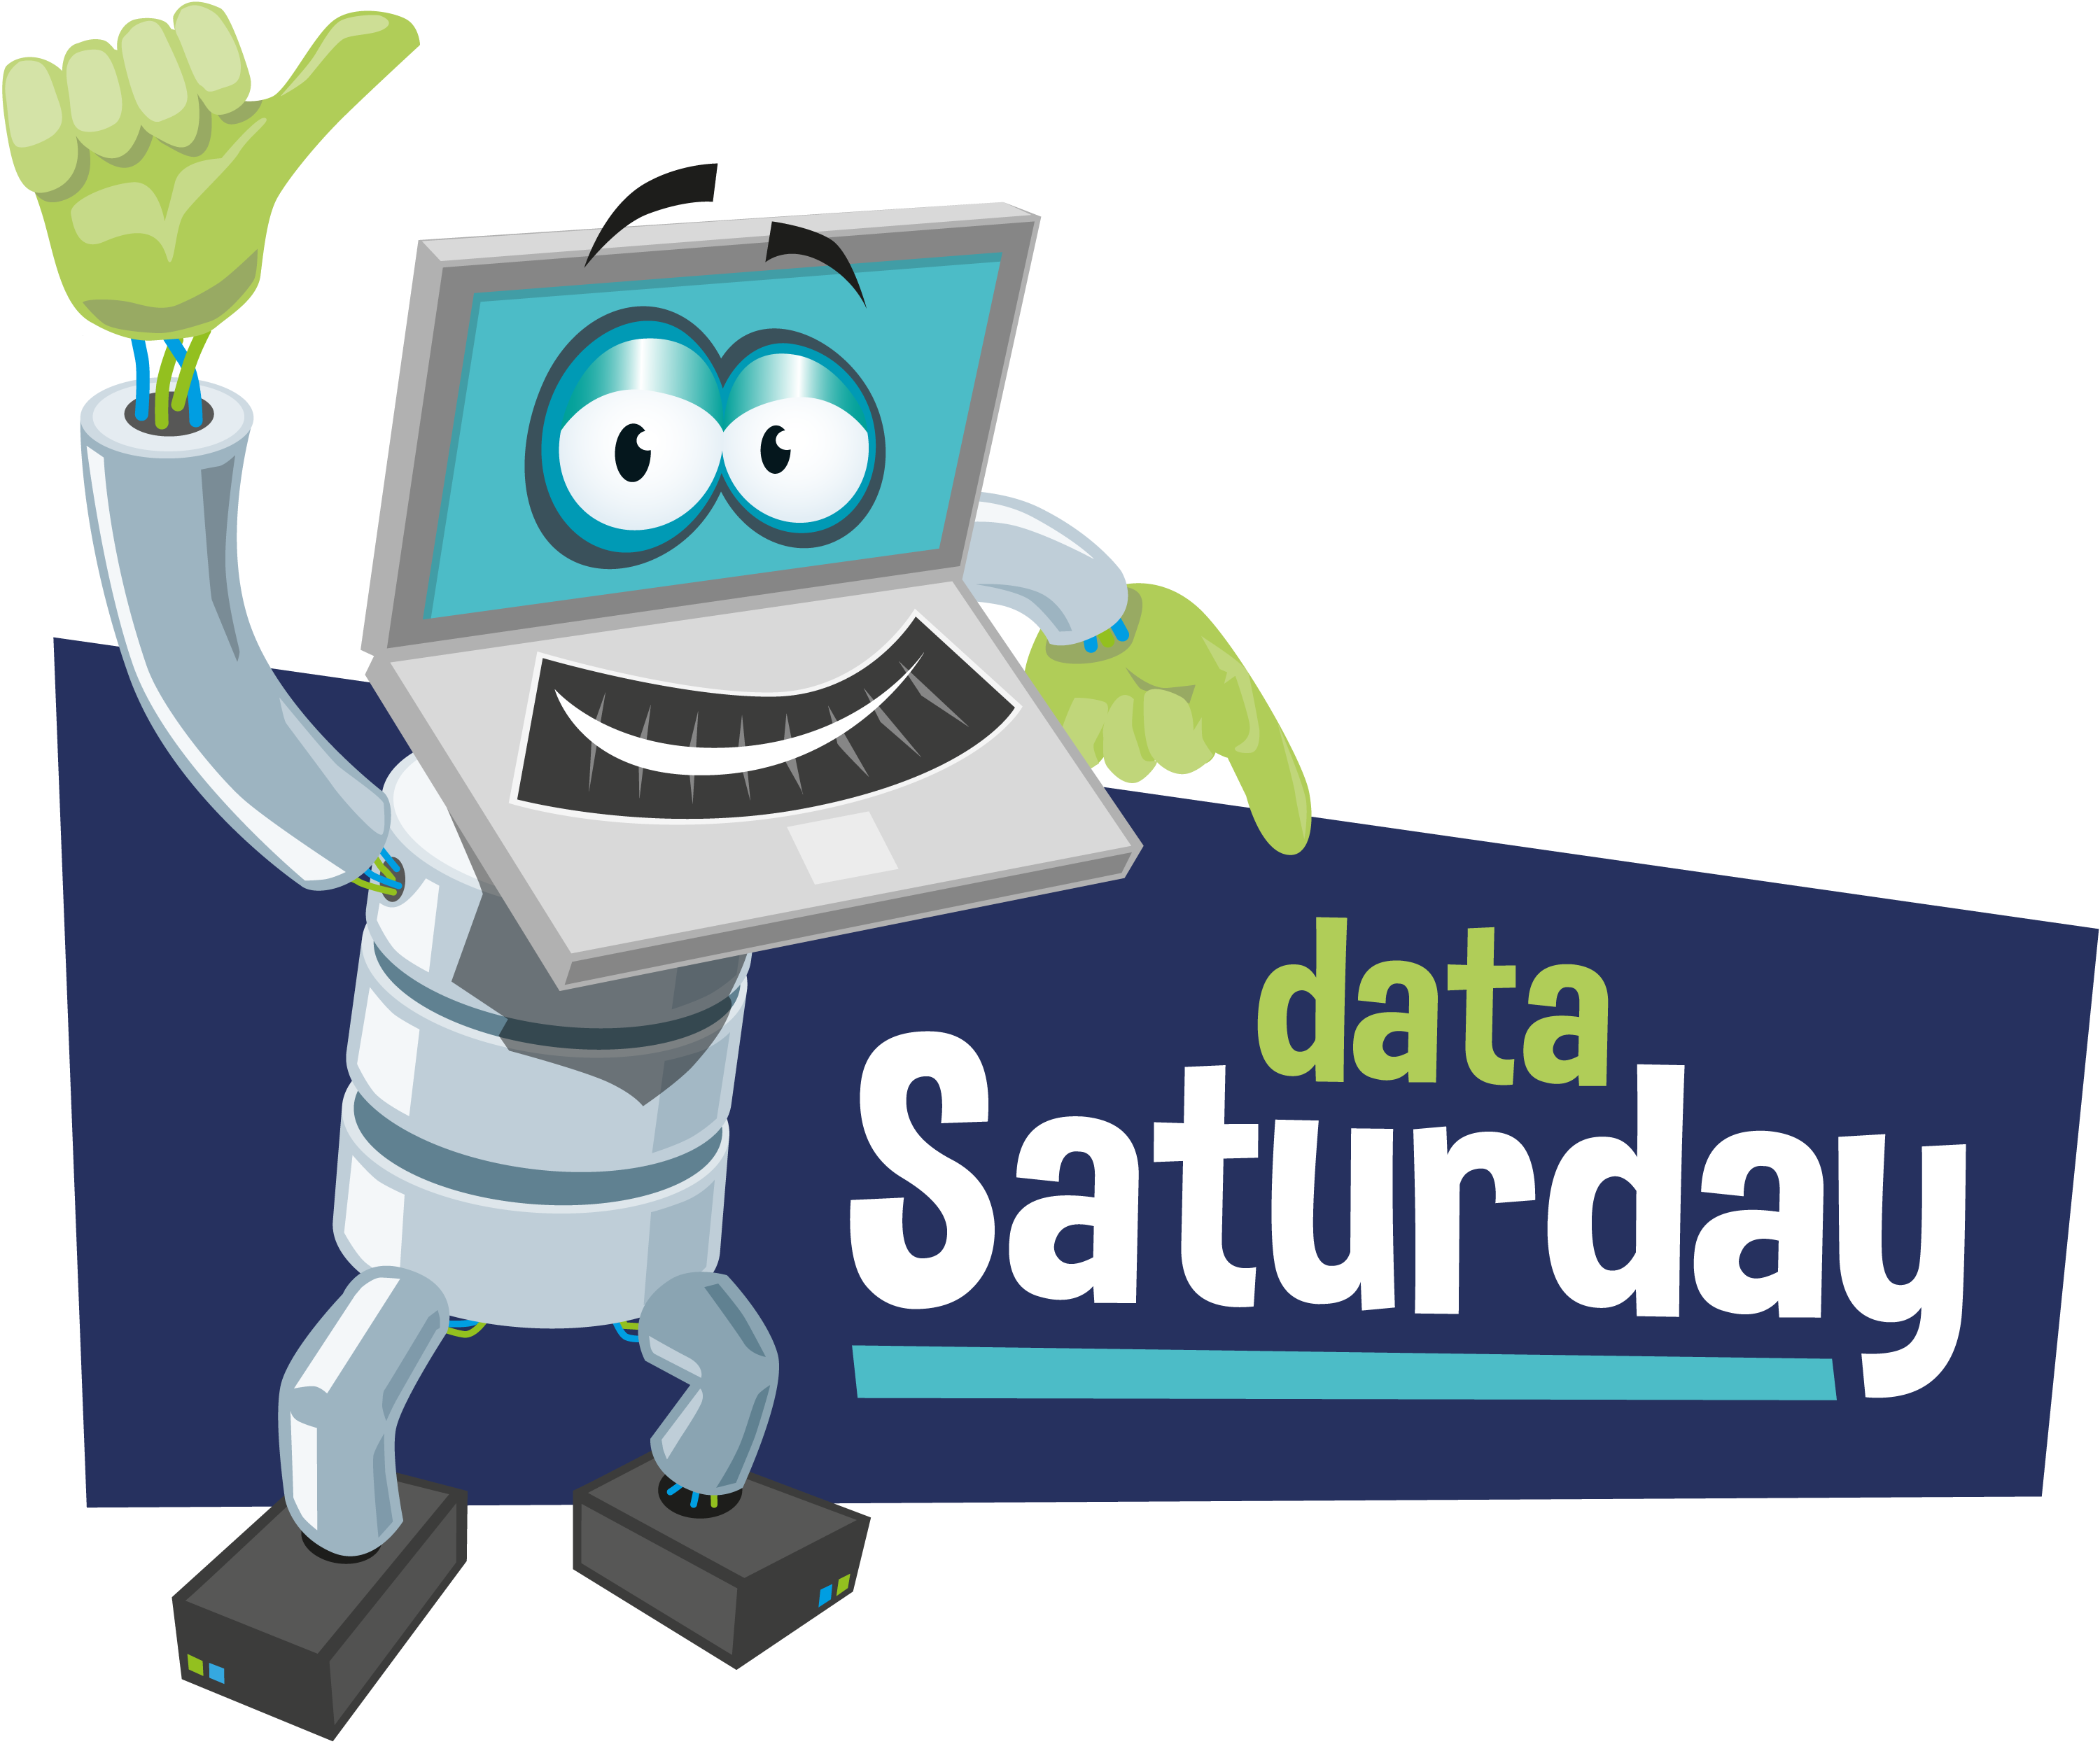









Sponsored by
Notes:
Please add this slide at the beginning of your presentation

Slide 6
Slides and Code
All my Presentations
github.com/SQLDBAWithABeard/Presentations

Slide 7

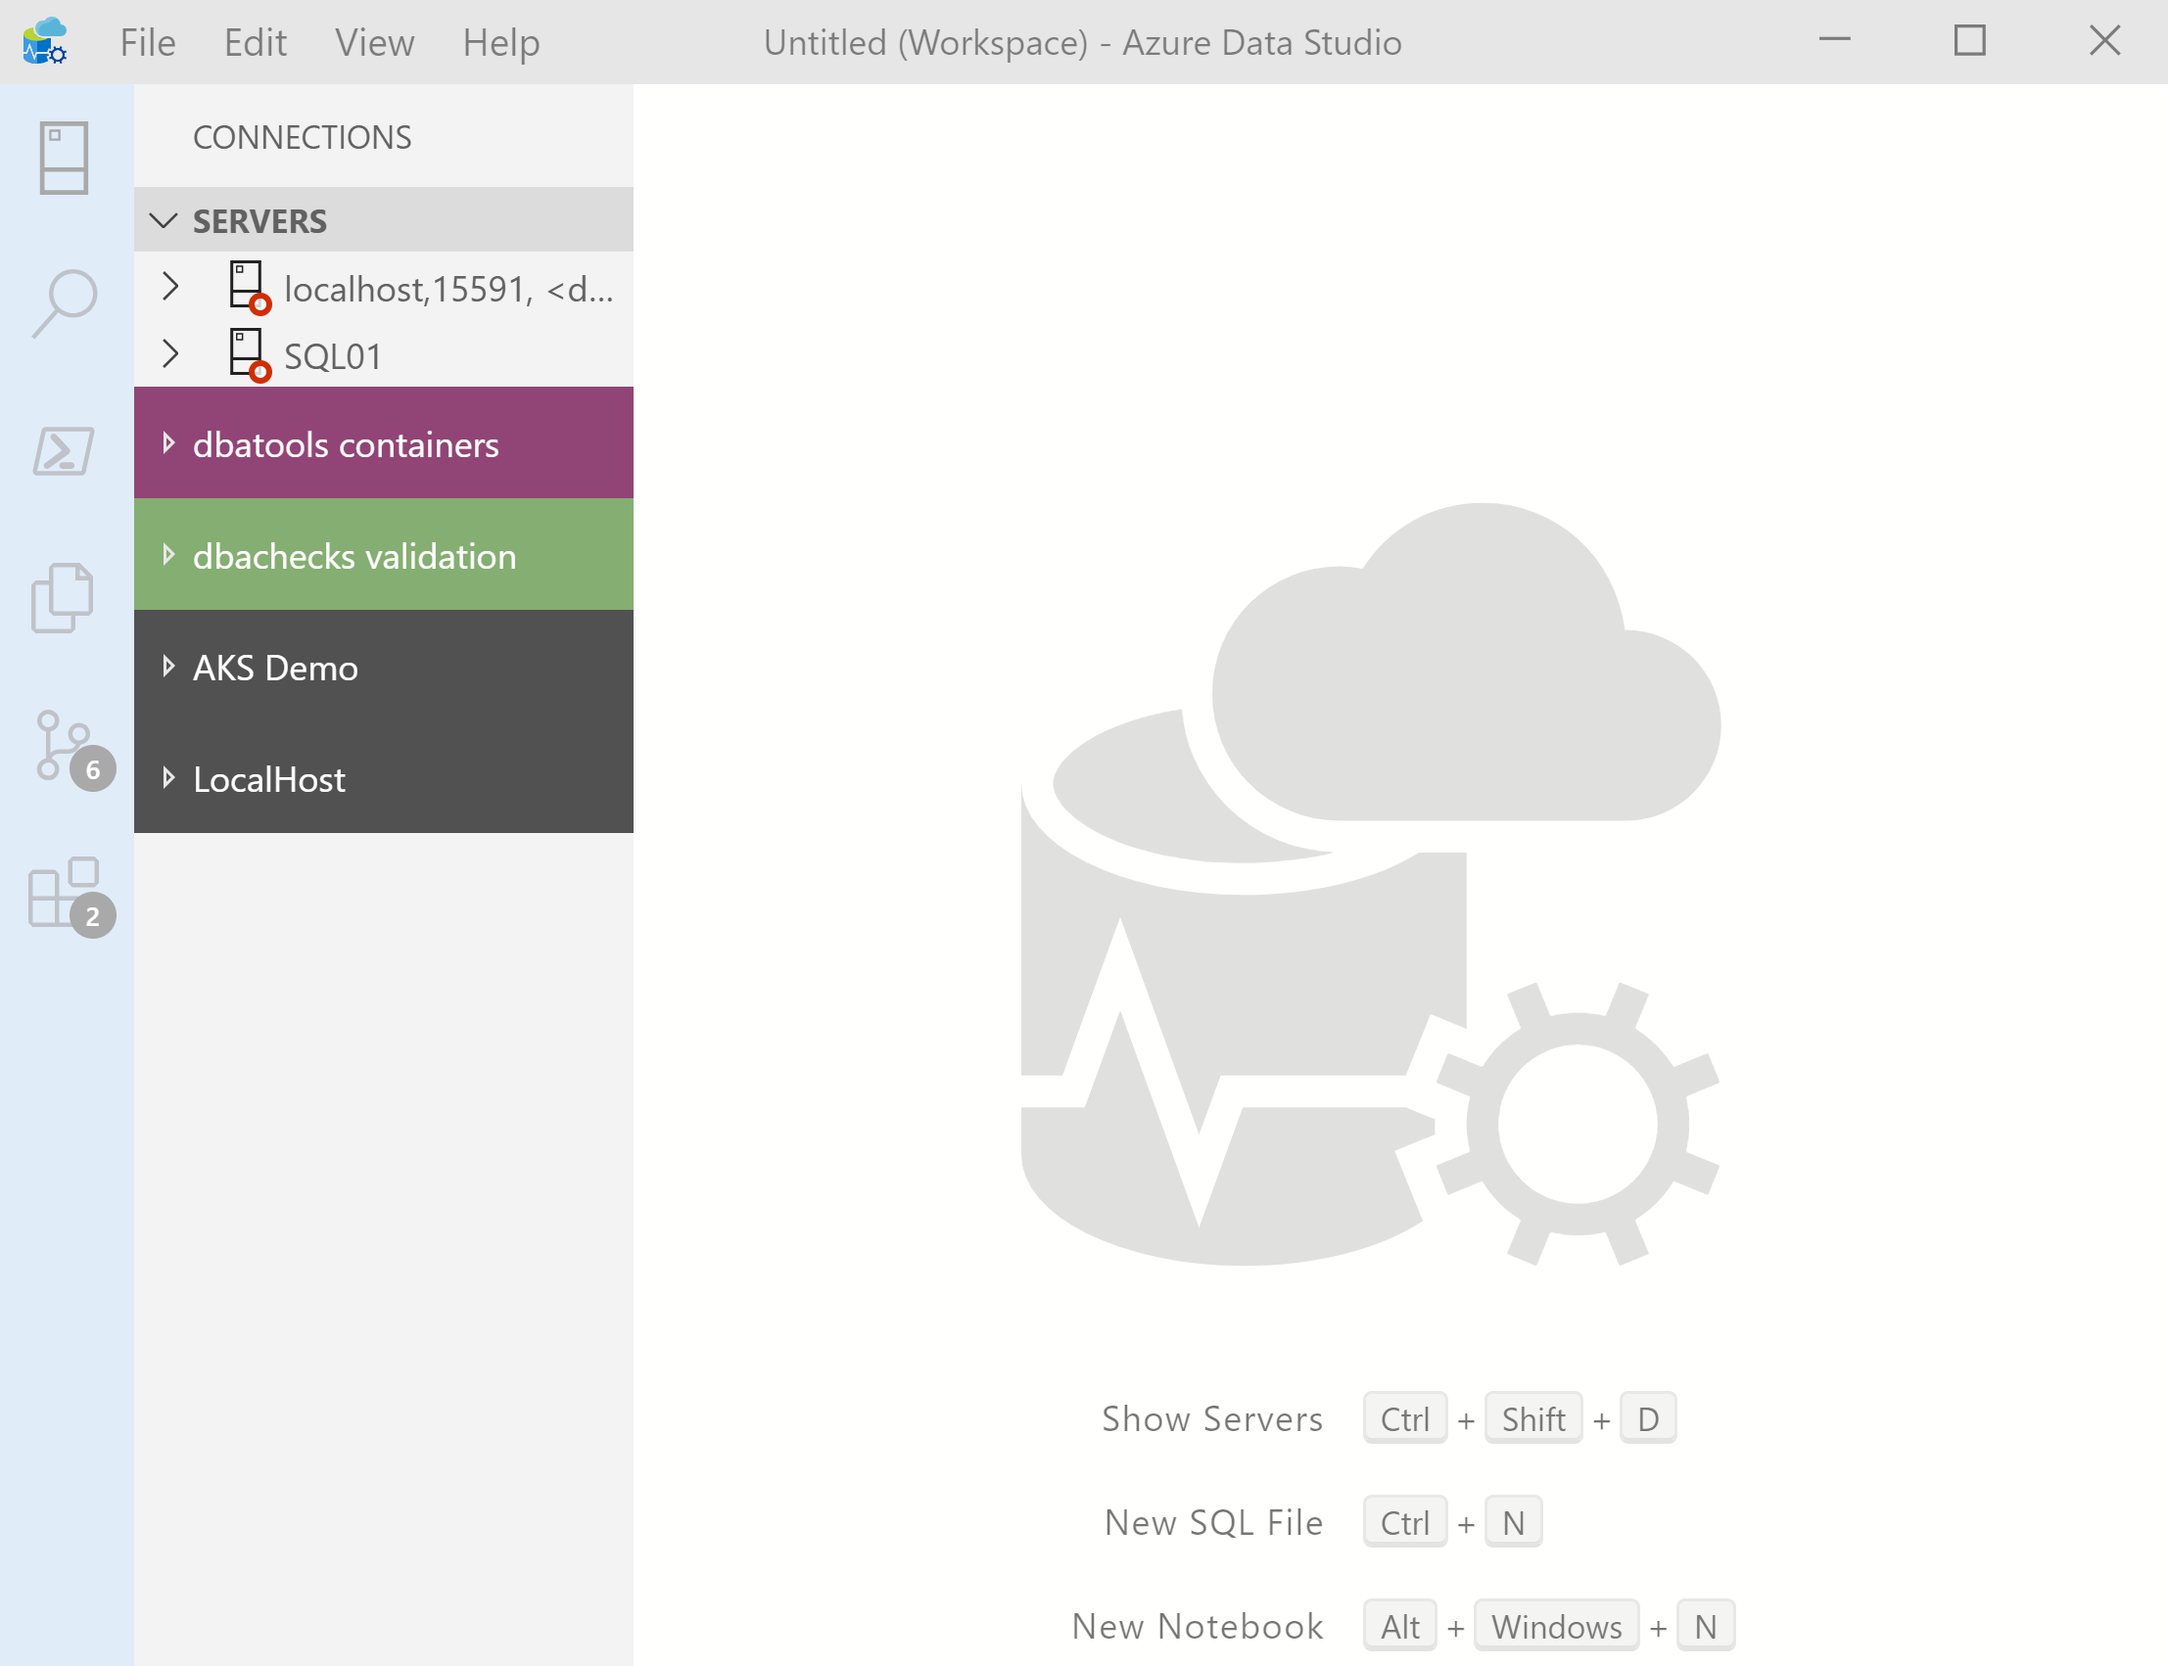
What’s Azure Data Studio ?
Cross Platform desktop environment for Data Professionals

Slide 8

So it’s only for Azure?

Slide 9
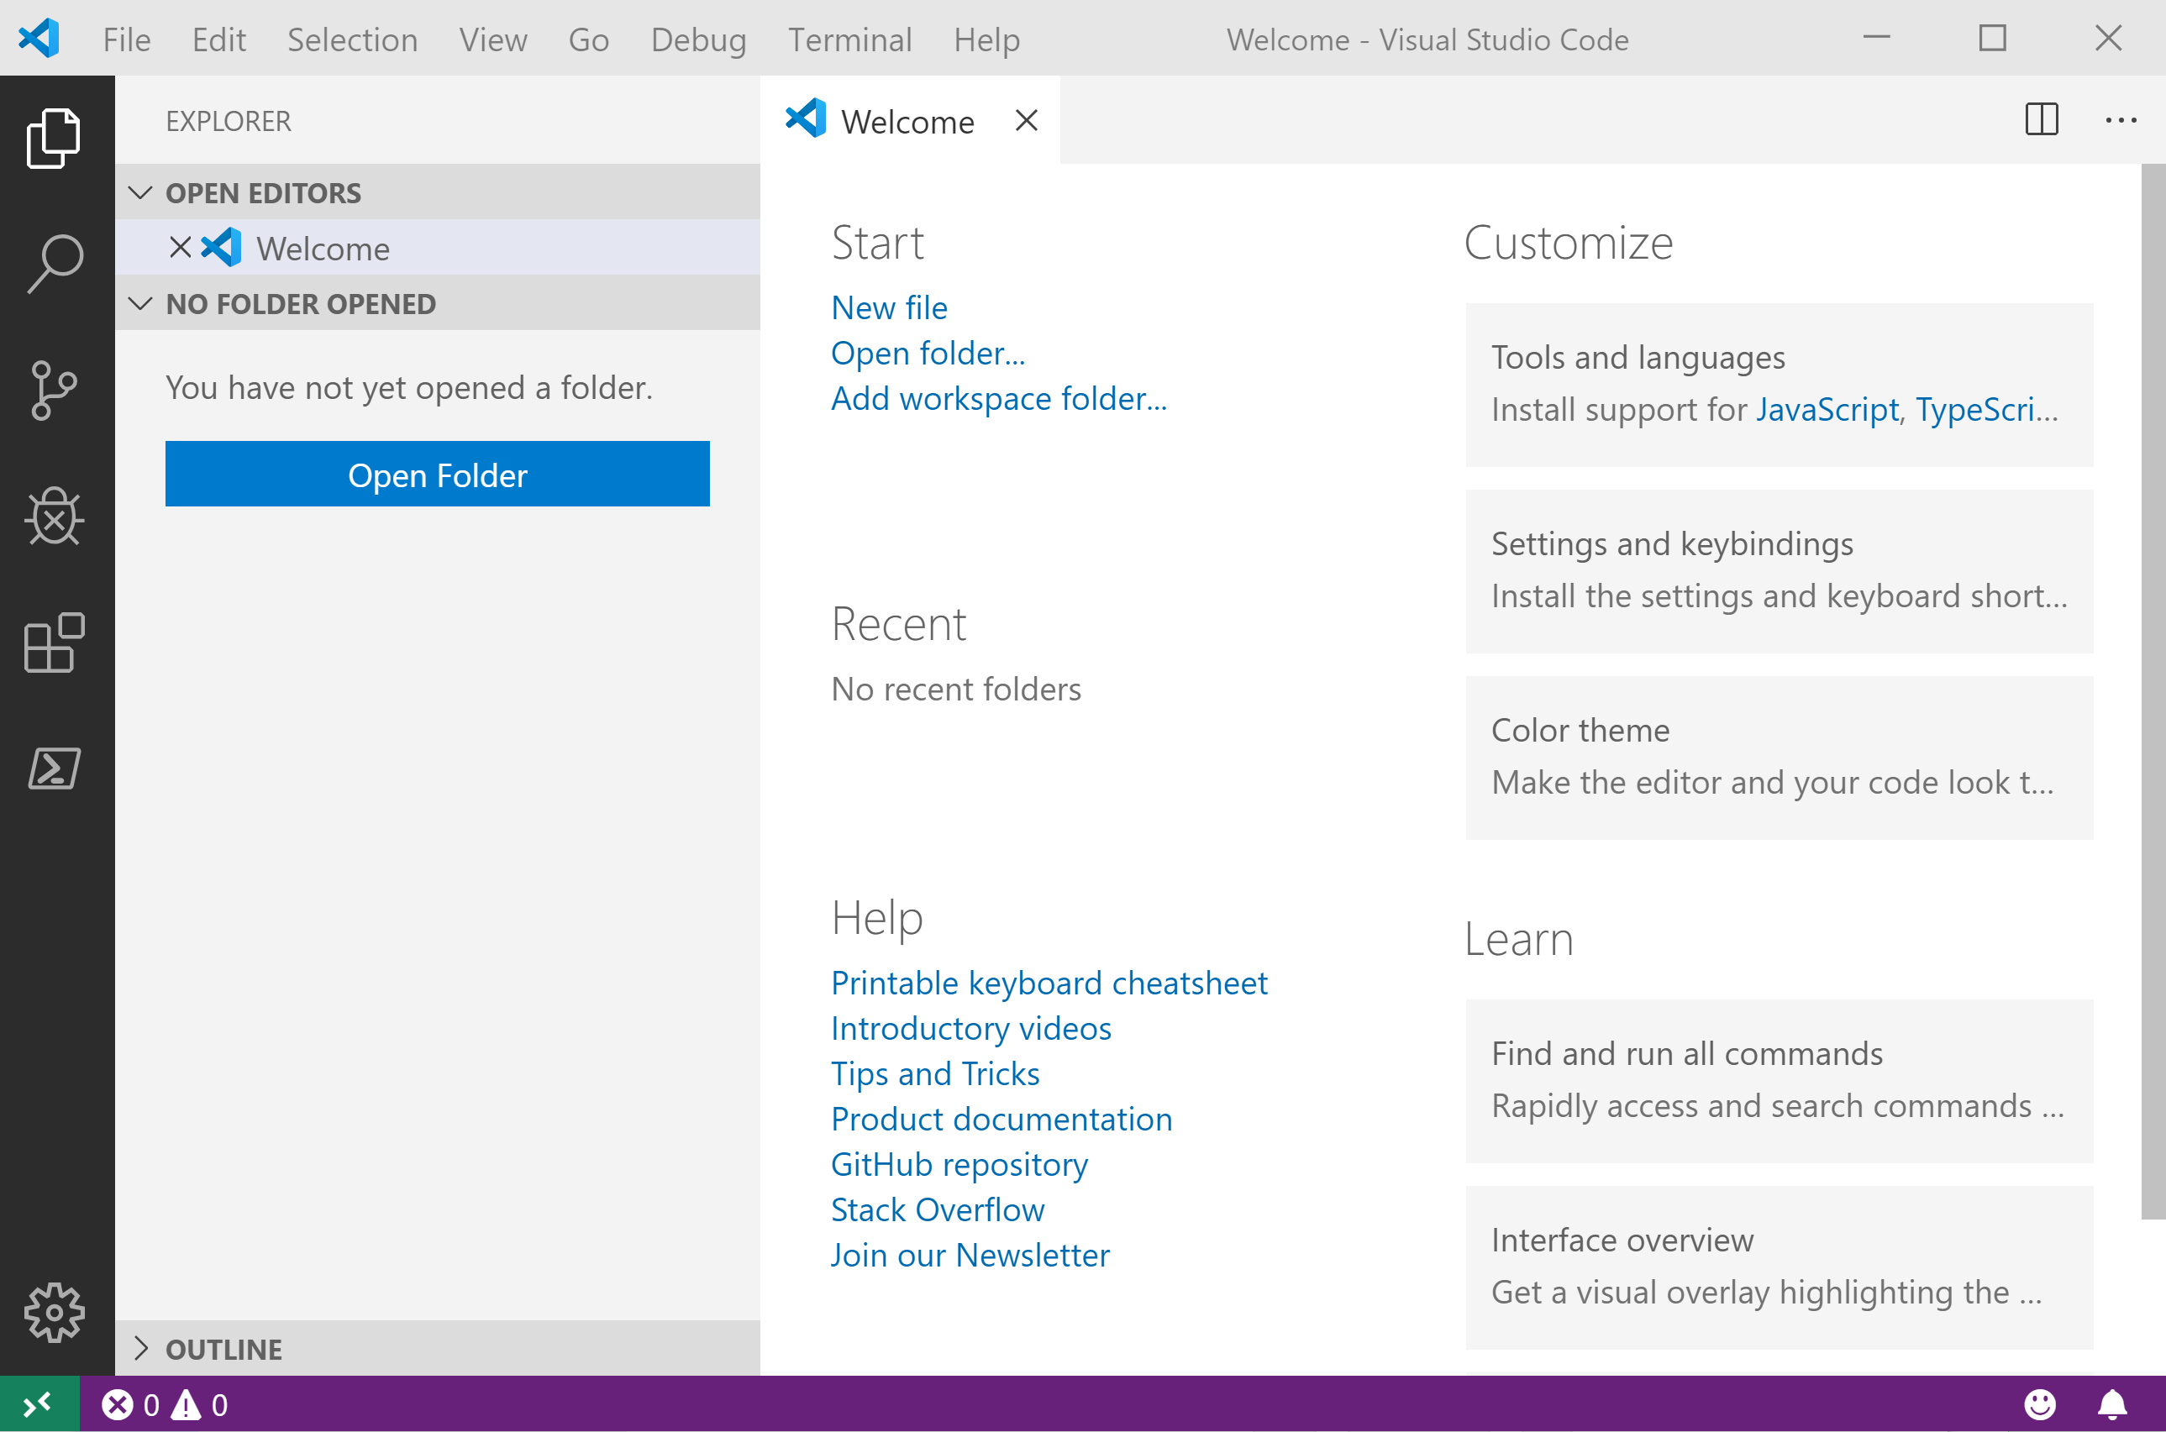
It Looks Like Visual Studio Code ?

Slide 10
It Looks Like Visual Studio Code ?

Slide 11
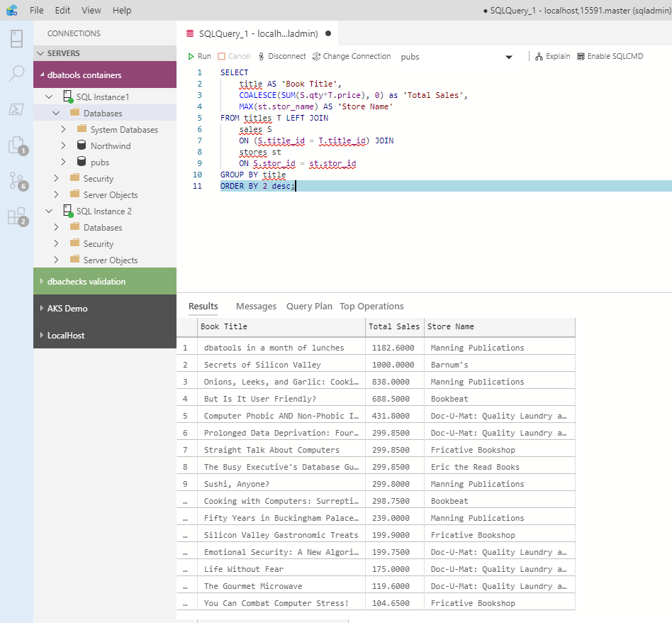
What can you do in Azure Data Studio ?
You can run T-SQL queries!

Slide 12
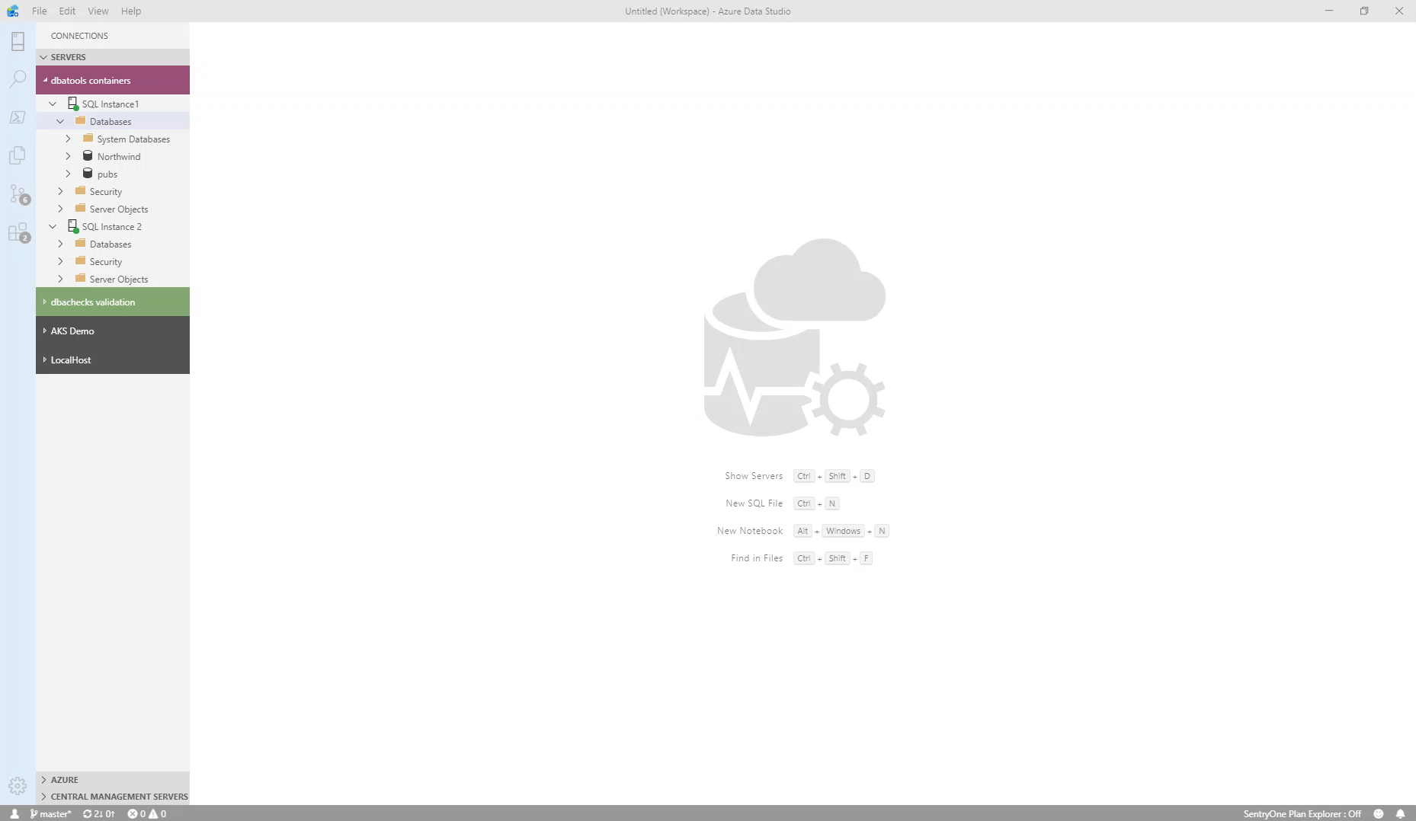
What can you do in Azure Data Studio ?
You can get execution plans

Slide 13
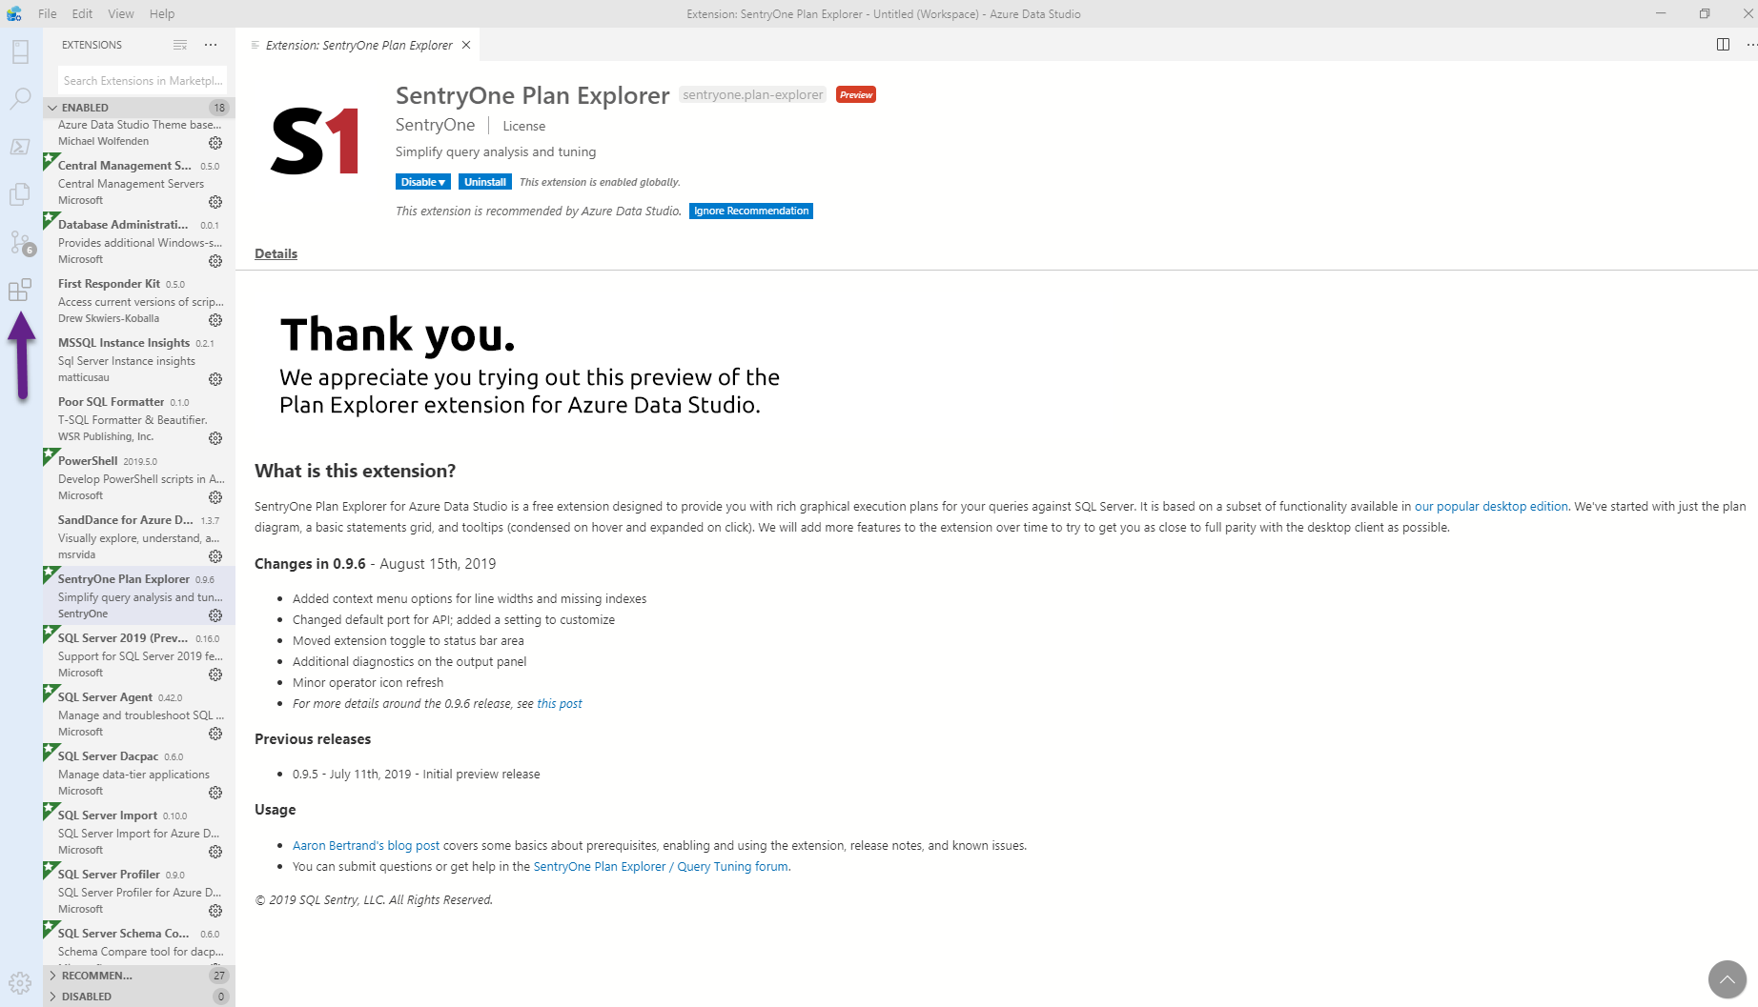
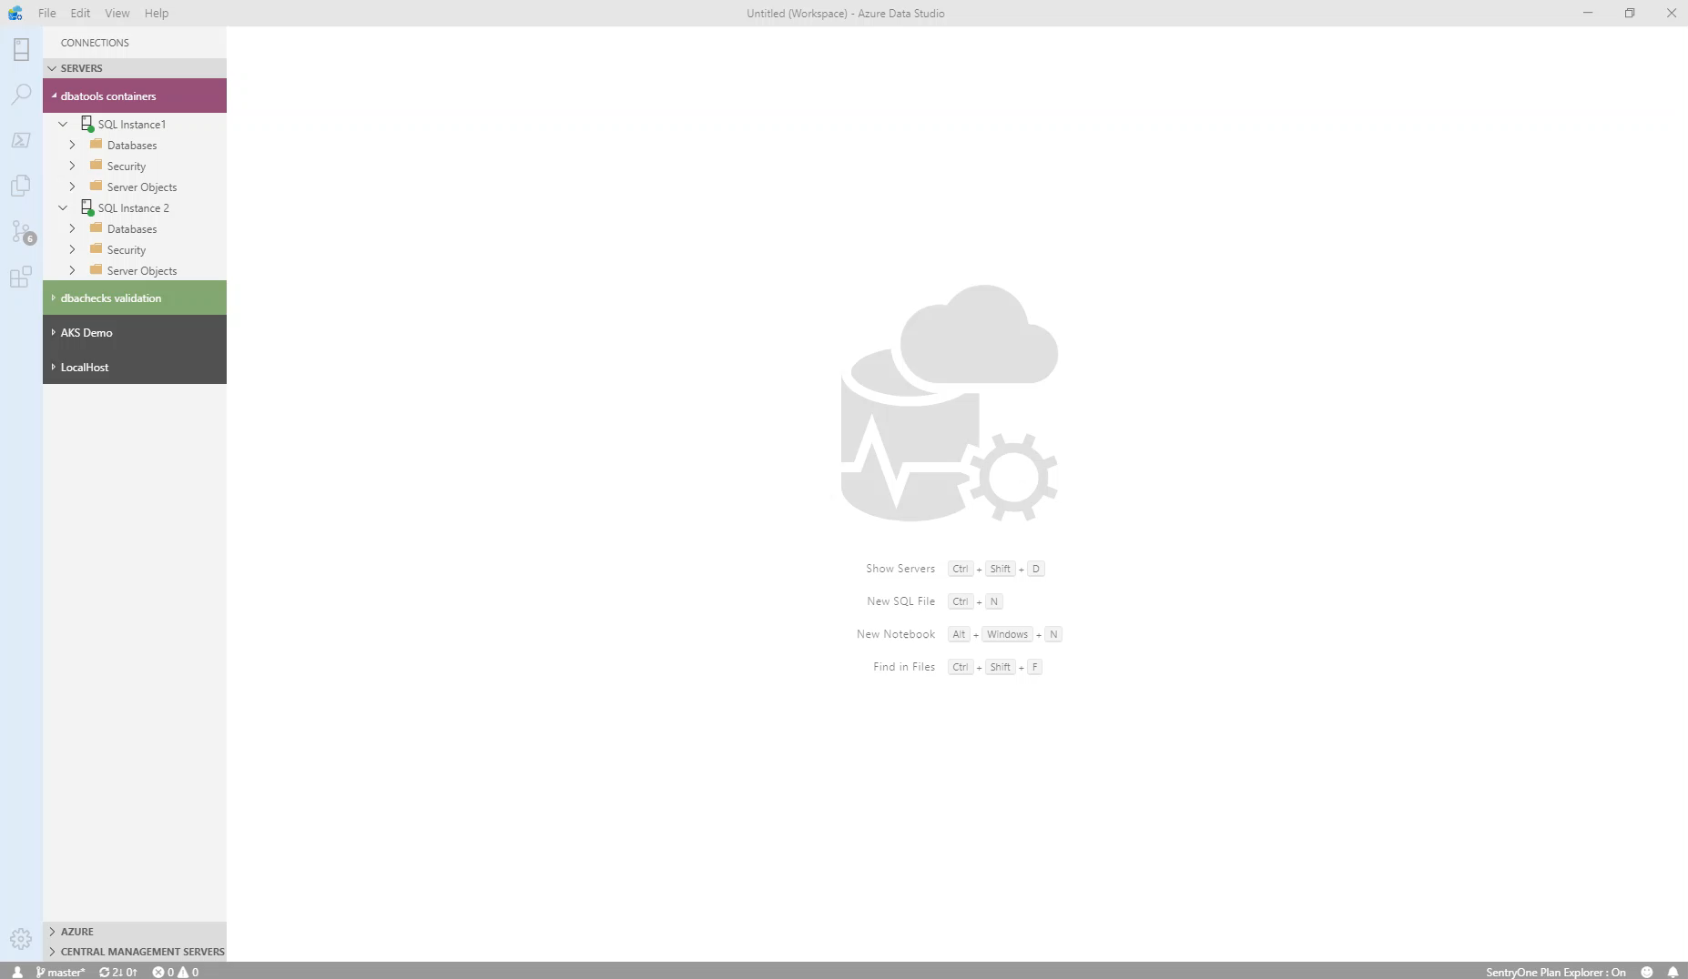
What can you do in Azure Data Studio ?
You can install extensions for more functionality

Slide 14
What can you do in Azure Data Studio ?
And get Plan Explorer

Slide 15
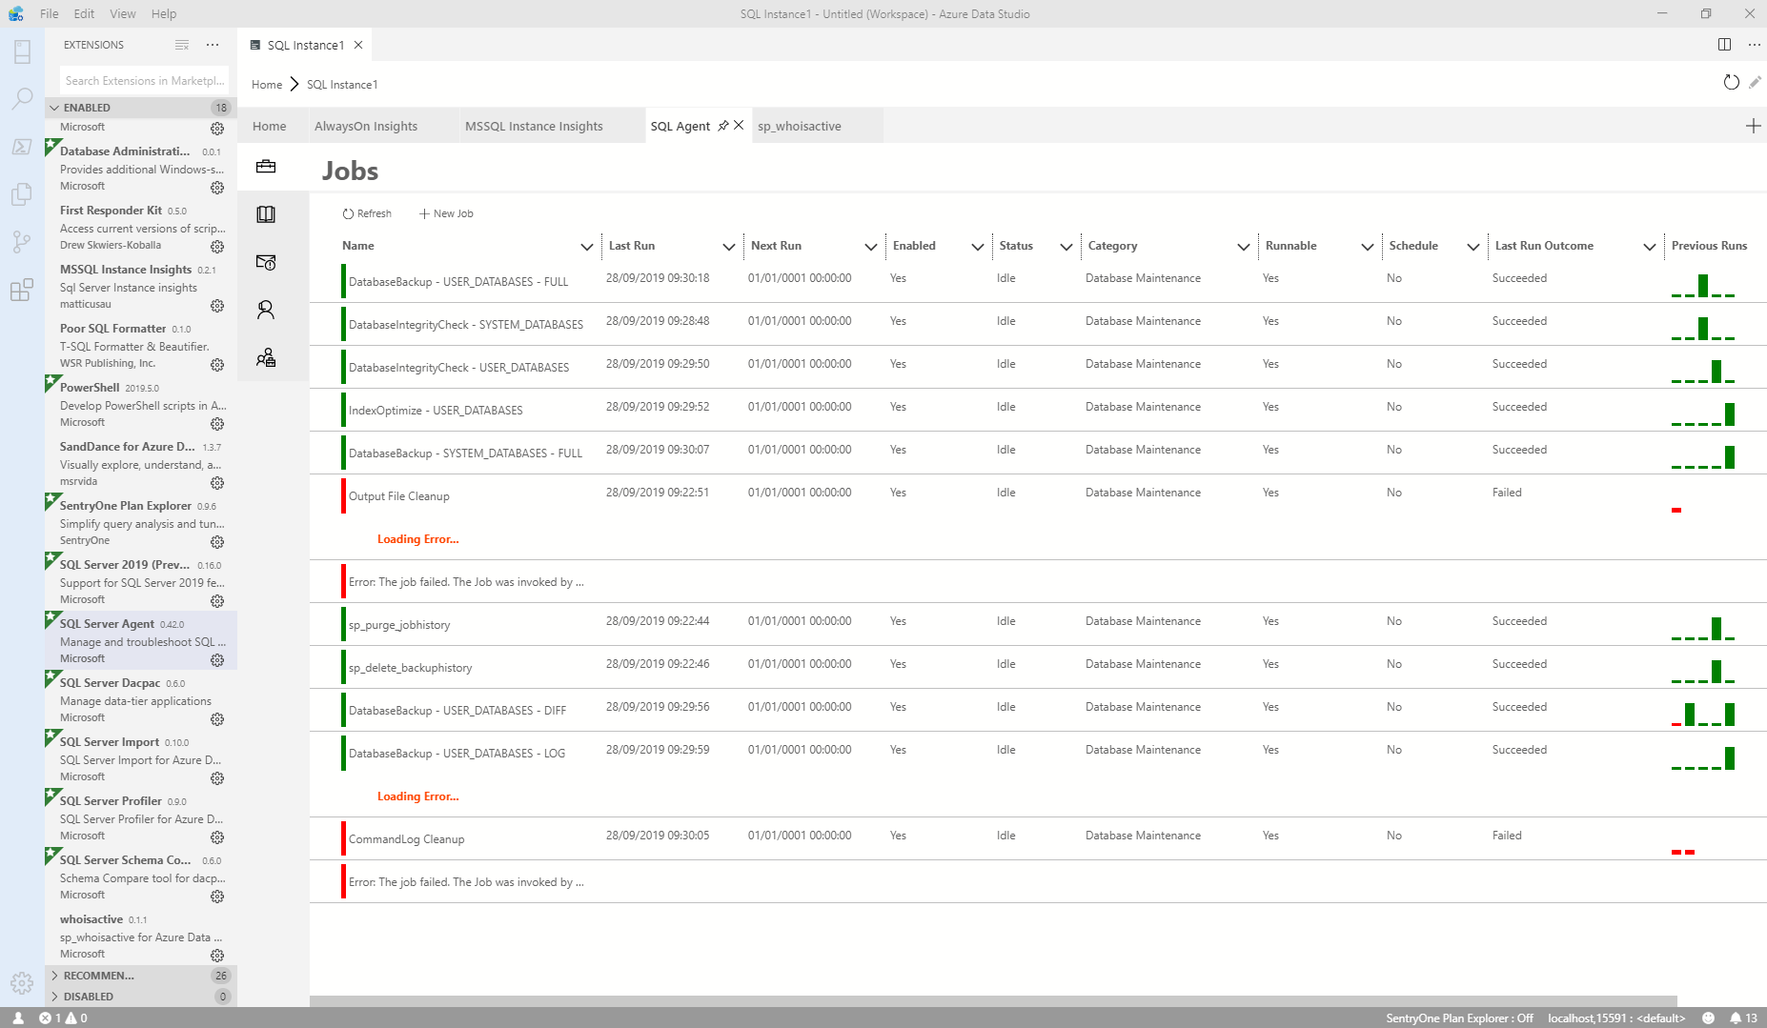
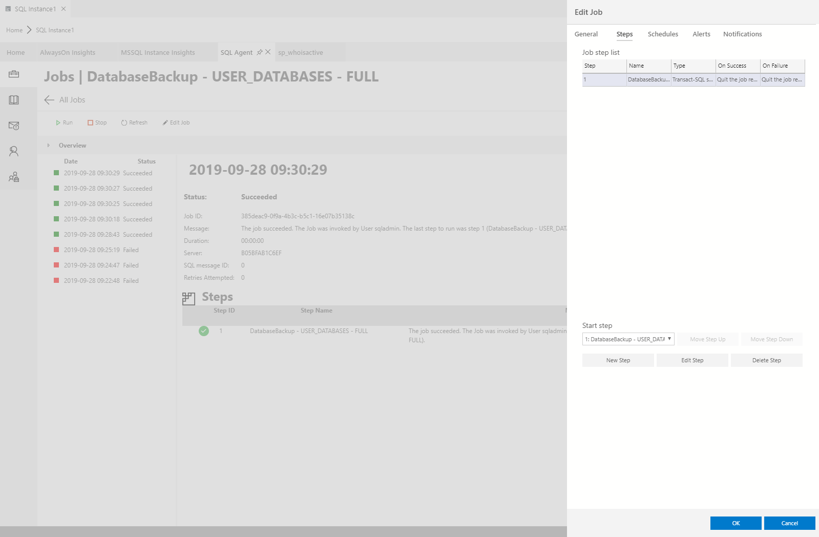
What can you do in Azure Data Studio ?
You can work with SQL Agent Jobs

Slide 16
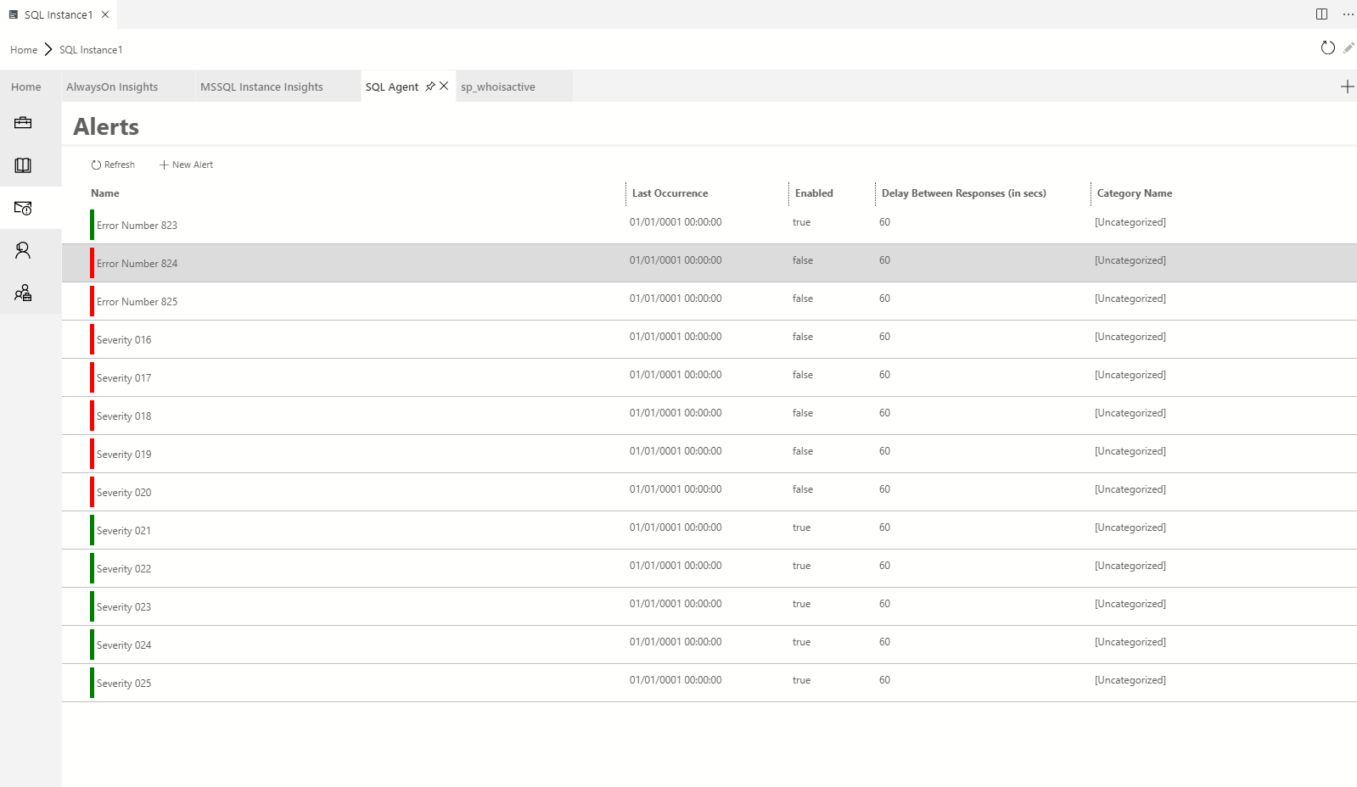
What can you do in Azure Data Studio ?
You can work with SQL Agent Jobs

Slide 17
What can you do in Azure Data Studio ?

Slide 18

What can you do in Azure Data Studio ?

Slide 19
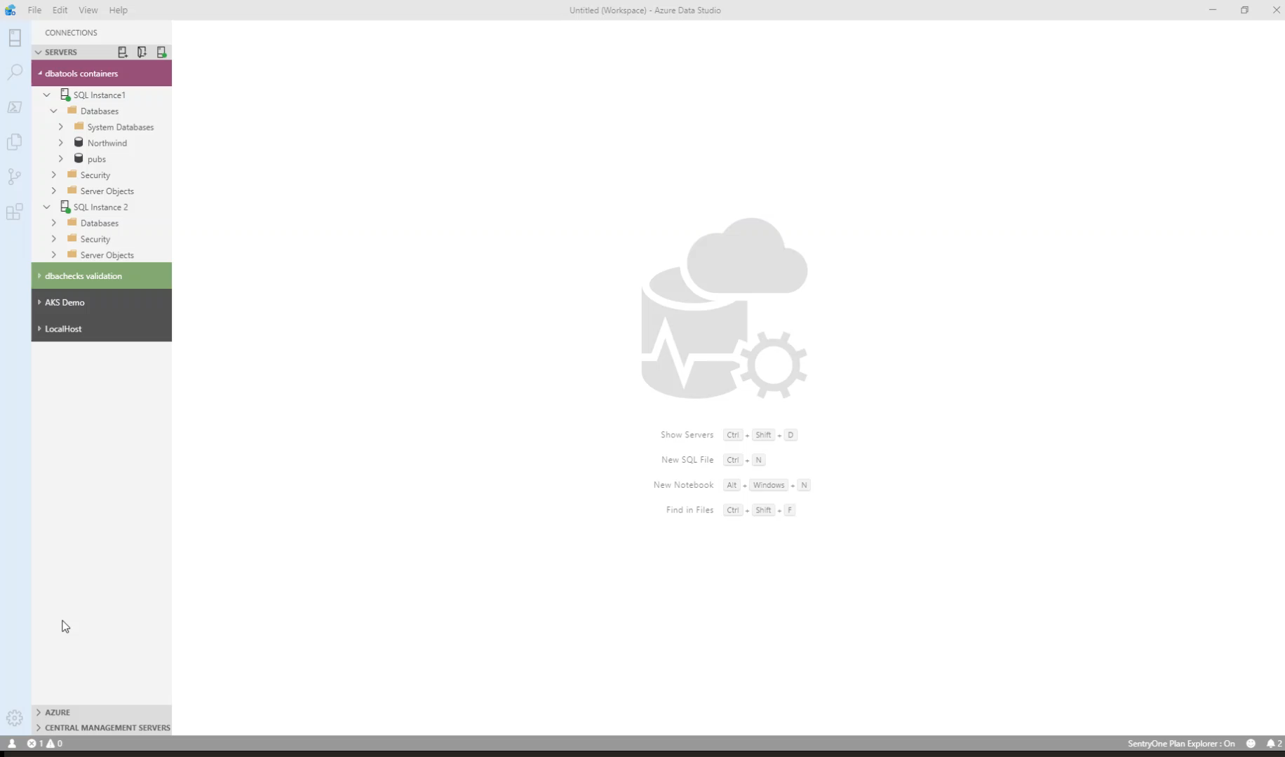
What can you do in Azure Data Studio ?
You can run PowerShell ☺

Slide 20
What is a SQL Notebook?

Slide 21
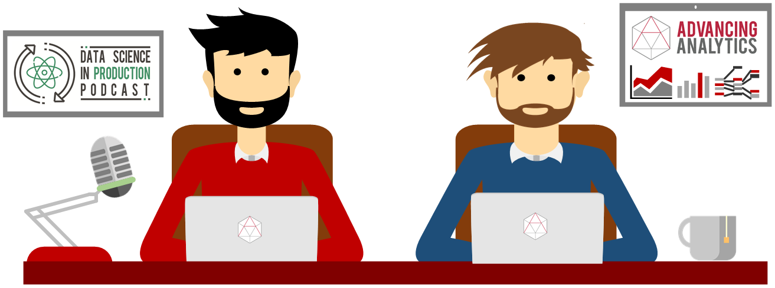
What is a SQL Notebook?
Originally for Data Scientists

Slide 22
What is a SQL Notebook?
Document that can contain text, code, images and query results

Slide 23
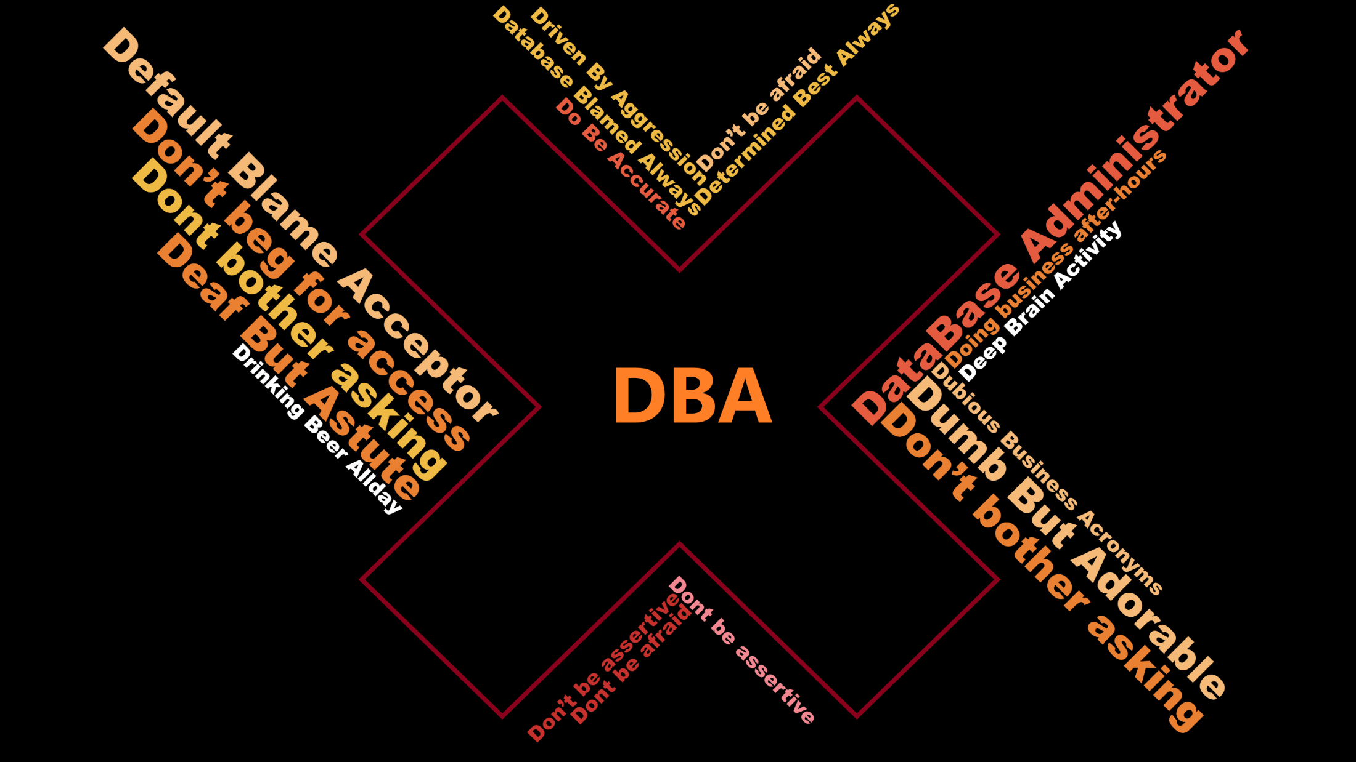

Slide 24

Let Your Mind Run Free
Photo by Alice Donovan Rouse on Unsplash

Slide 25
Some Ideas
Run Books
Training
Incident response templates – for Service Desk and for DBAs
Templates for common functions
Demoing

Slide 26

Buckle Up !! It‘s Demo time

Slide 27

Session Evaluation
Notes:
Please add this slide at the end of your presentation

Slide 29

Event Evaluation
Notes:
Please add this slide at the end of your presentation too if you are the last session of the day (16:00 to 16:45)

